Slide 1
Class Activity : UADY Website
Alexandre Bonnin
Gerardo Dueñas
Antoine Le Loarer

Slide 2
Quality of an ui :
Understandable by the user
Obvious preferred action fro the user
Make an complex Action more easy for the user
Be honest to the user

Slide 3
why University website are bad?

Slide 4
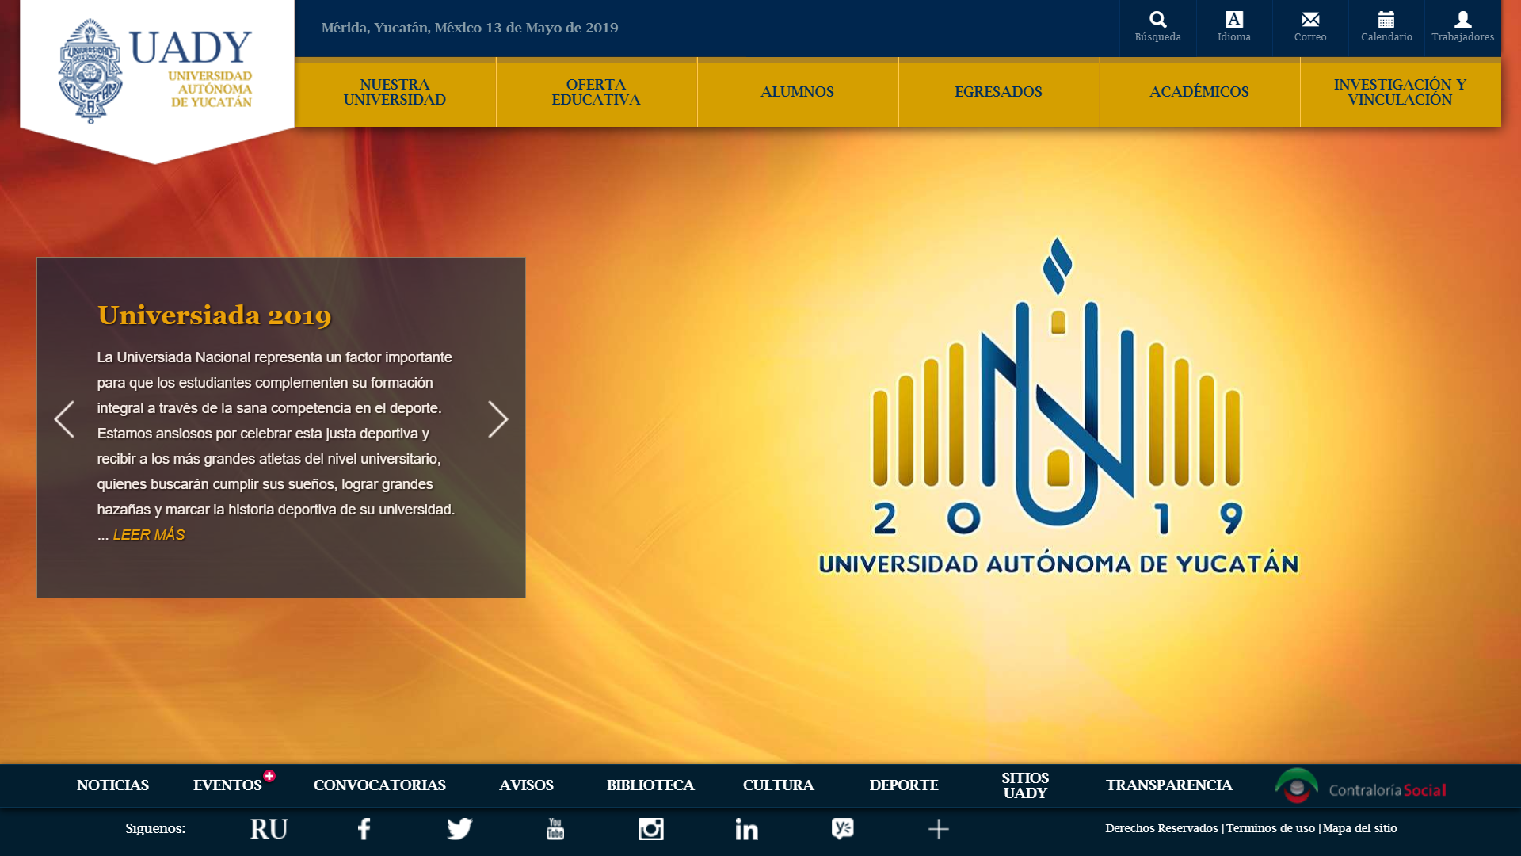

Slide 5
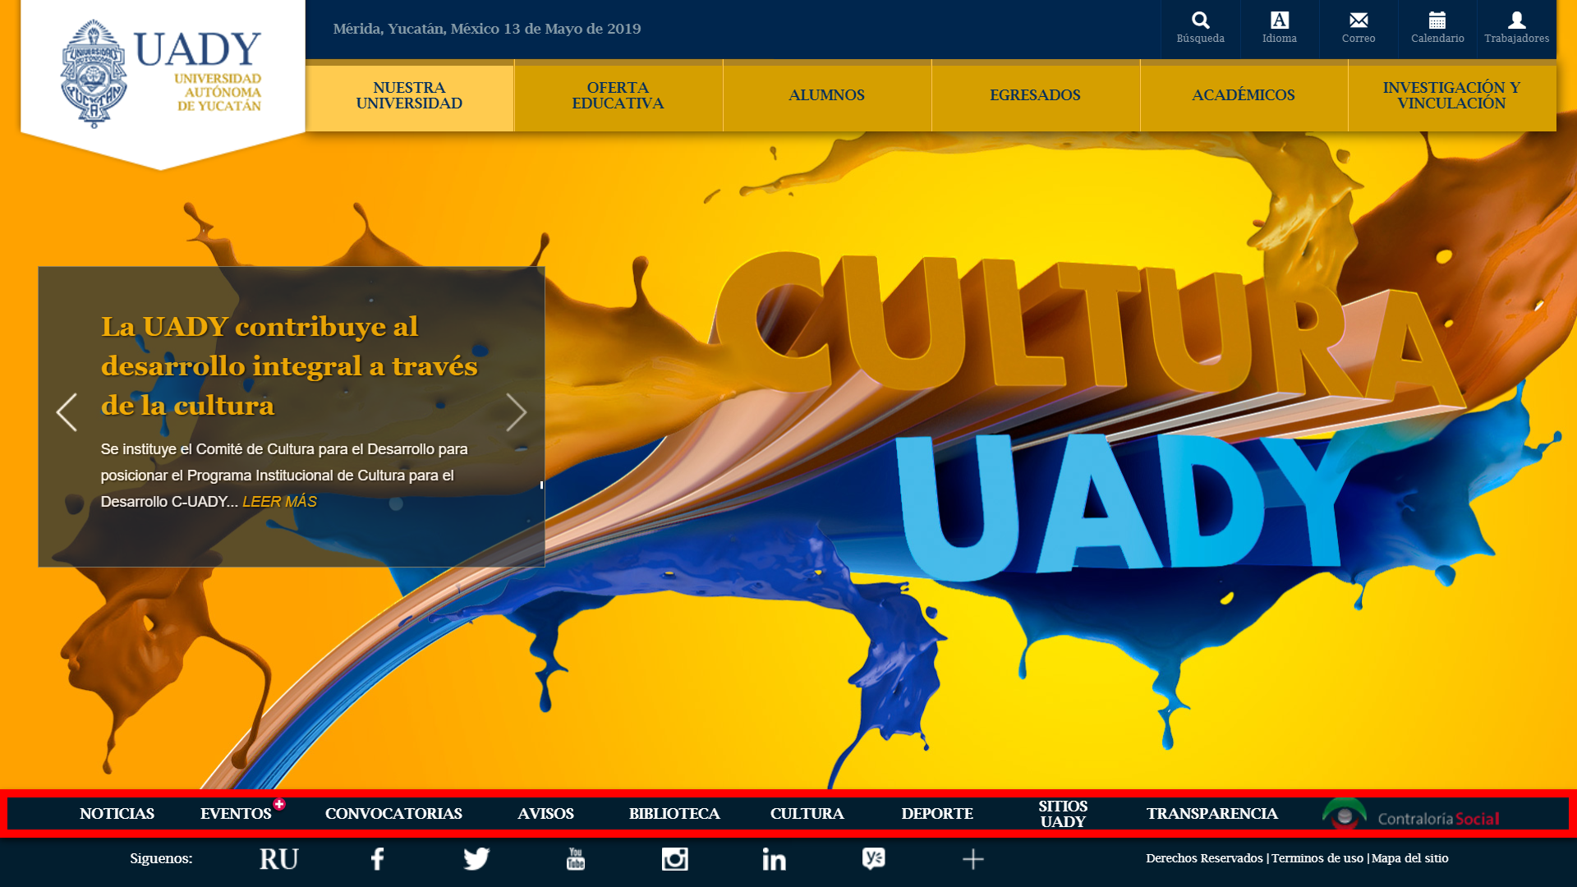
1 : What is the principe broke here?

Slide 6
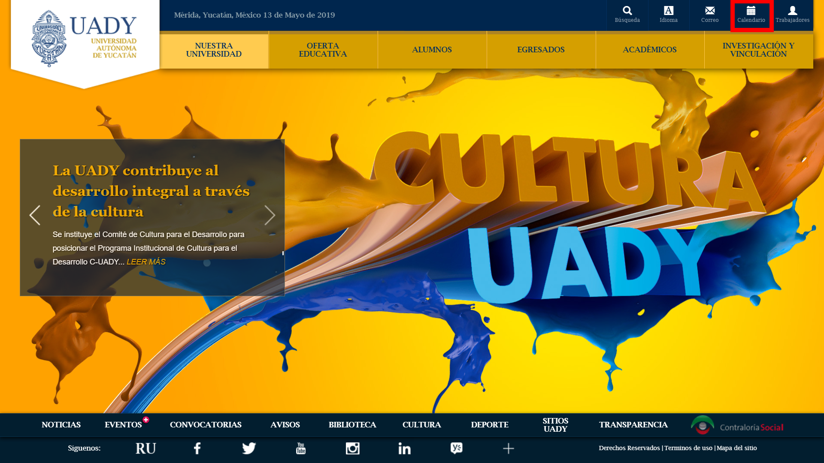
2 : CALeNDAR !

Slide 7
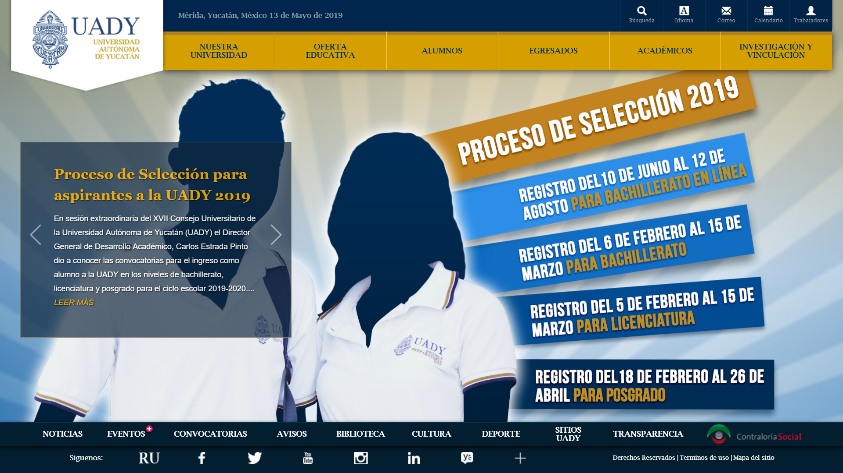
3 : I want to know information about Law degree

Slide 8
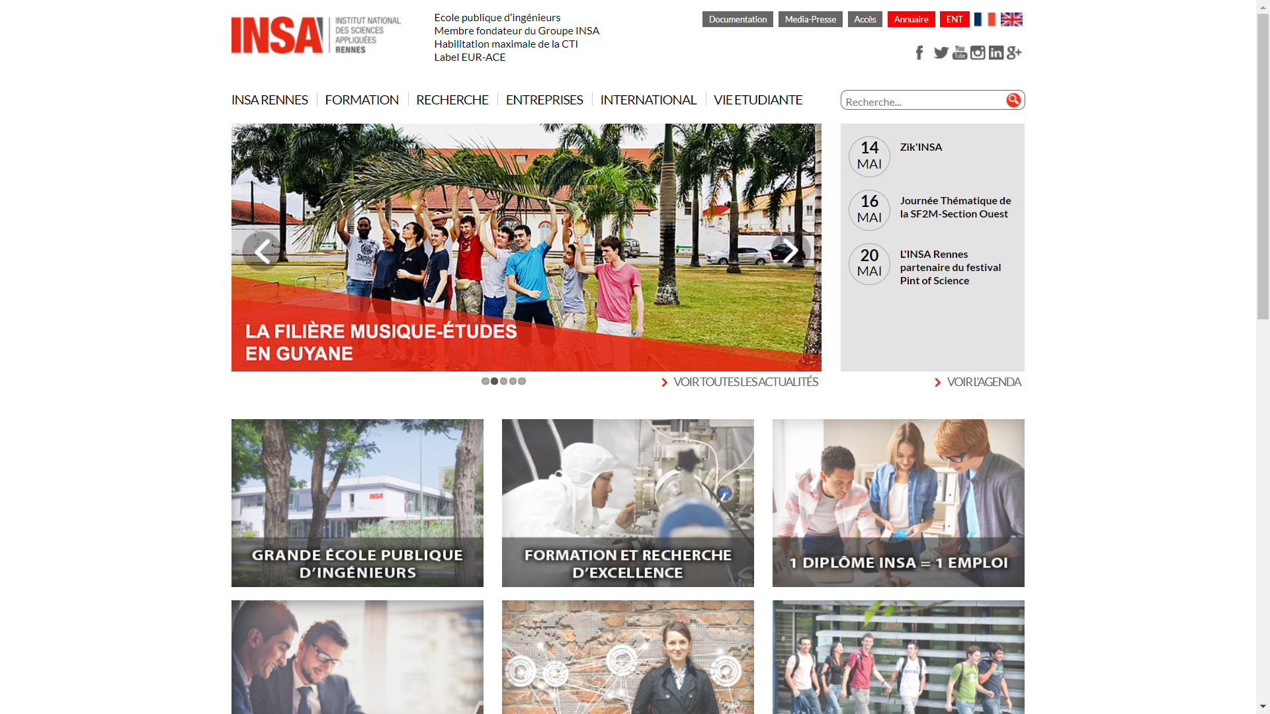
3 bis : I want to know information about Computeur science

